Slide 1

Senior Software Engineering Final Project
Group 4 – joshua bonham, Demarcus braclet, Daniel agu, stephanie Alonso, kaiden gallardo, michael tanjuakio
Planning Poker for Everfox

Slide 2


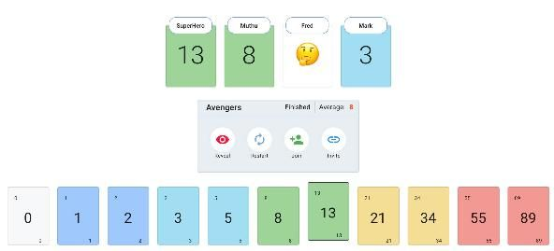
Introduction
What is playing Poker?
  Planning poker is a planning and estimation technique used by Agile teams after a product backlog has been created. The setup of this technique helps software teams accurately estimate product development time frames, improve collaboration, and strategize the work to be done.

Slide 3
Scope – Planning Poker
The webapp shall run in a container on an x86_64 Linux system
  The container shall be managed by Podman or Docker
The container shall include all necessary services to host and run the webapp
Be connected to with URL on an IP address and port inherited from the host system:
  Example: http://192.168.1.100:9999
When no session is currently started, connecting users will see a start session screen
  The start session screen shall have:
    Input box for hosts’s name
    Input box for session topic
    Button to start the planning poker session
    The button shall function only when both inputs are filled
Allow up to 20 users to connect to an existing session

Slide 4
Scope 2 – Planning Poker
Both host and users shall:
  See the host’s name and session topic at the top of the screen
    Example: Dustin Endres – Planning Poker Estimation
A textbox containing the current round’s topic
Row(s) of cards with each player’s names under them
  The cards are silhouetted when no vote
  The cards become grey when a vote is cast but not yet shown
Allow users to join and leave an existing session at any time
  Both users shall exit by closing the page
    When the page is closed by a user, they shall be removed from the table
    When the host closes the page, the session will end for all users
      A screen shall be displayed to user’s indicating the session has been ended by the host
      Upon rejoining the URL, a new session should be started

Slide 5
Scope 3 – Planning Poker
See a hand of cards at the bottom of their screen o The hand shall consist of cards with the values:
  Pass, ?, 1, 2, 3, 5, 8, 13, 21
When a user clicks on a card, it shall rise above the others and show they have picked a card to all players
  Users can select another card to switch their vote
  Users can click the same card to retract their vote
The host shall:
  Have a set of buttons on their screen to:
  End round to show all user’s cards
  If a user has not voted, they shall automatically play “pass”
  Invoke a countdown for all users to be displayed at the top of the screen
  Reset the round
  Edit the round’s topic description displayed on the screen

Slide 6
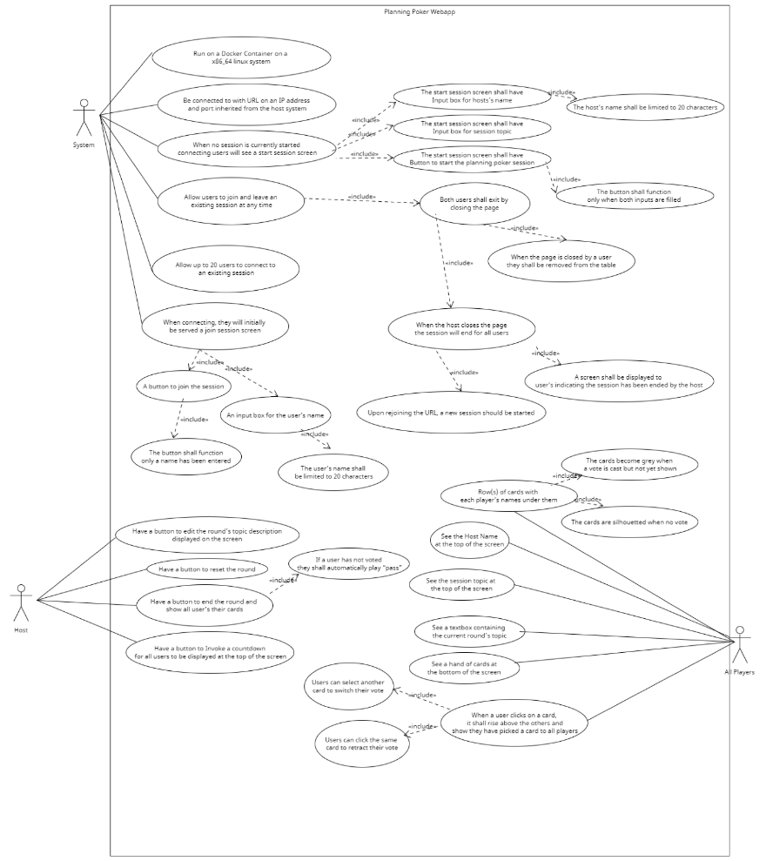
Deliverables - 1
Project Management Plan [9/6/24]
  Specifies scheduling, standards, risk analysis, lifecycle model, and our project's software/hardware requirements
Requirements Documentation [9/20/24]
  Discusses about use cases, textual descriptions, and displays a use case graphic
Architecture Documentation [10/18/24]
  Details the architectural model/style of the project.
Detailed Design Documentation [11/1/24]
  Documents overall design of the project such as the GUI, a Static model, and a Dynamic model

Slide 7
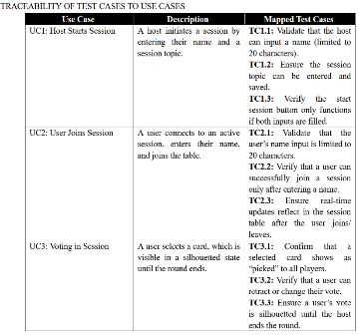
Deliverables - 2
Test Plan [11/15/24]
  Documents test cases, test generation, and test plan
Final Project Presentation Slides [12/3/24]
  Showcase of the project and overall process
Final Project Demo [12/3/24]
  Demonstration of our webapp in action
Final Project Report [12/5/24]
  Everything mentioned in the deliverables encapsulated in one document

Slide 8

Methodology
Agile Methodology
  Used to increment and iterate over the project
  This will help us have communication with the client consistently
Software Resources
  React
  Express
  Socket.IO
  VSCode
Hardware Resources
  Linux
  Local Host

Slide 9

Methodology
Project Organization
  Everyone is considered a full stack developer
  Equal opportunity for learning new technologies
Version Control
  GitHub
  GitHub Desktop
Communications
  Discord
  Zoom

Slide 10

Results
Final Product Results
  We were able to get the final product before the due date
  All the requirements were fulfilled
  Bugs were tested and corrected
Our team learned:
  React JS
  Docker File
  Linux
  Version Control

Slide 11

DEMO

Slide 12
